Slide 1
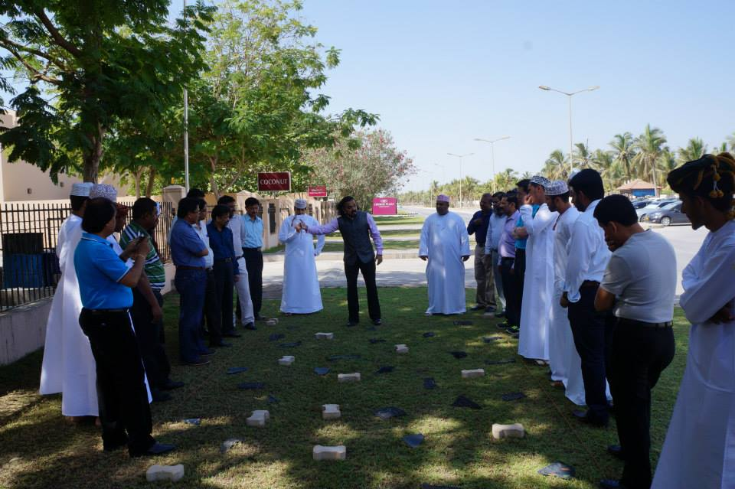
CORPORATE PRESENTATION

Slide 2
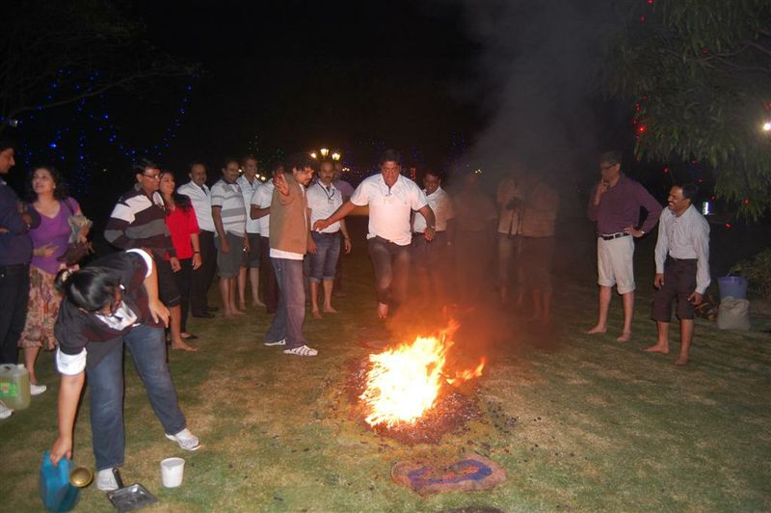
TABLE OF CONTENTS
01
02
03
04
05
About The Next Dimension
Founder & Trainer Details
Details about the workshop
Client’s Testimonials
Contact Details
CORPORATE PRESENTATION

Slide 3
ABOUT OUR ORGANIZATIONS
Cogniizant Transformation and The Next Dimension was established with the INTENT of empowering people with tools for achieving profound transformative change at the individual, organizational and societal levels.
Our services cater to a comprehensive range of learning solutions along with high impact personal breakthrough sessions like:
FIREWALKING, GLASSWALKING, IRON BAR BENDING , customized transformational workshops like Achieving Peak Performance, Passionate Selling, The Radical Peak Performance, Unleashing Creativity, Creating High Performing Teams, Relationship Mastery and many more
CORPORATE PRESENTATION

Slide 4
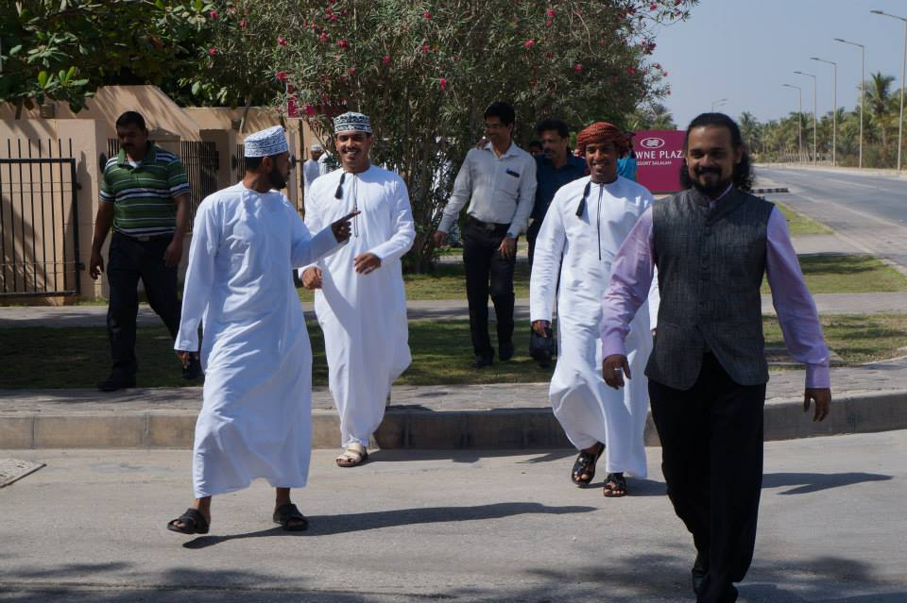
OUR POWERFUL PROCESS
Identifying the core purpose
Customize the Workshop
Measure the impact of the workshop
Feedback post the workshop
Reinforce learning post workshop
Identify perceptual problem and core issue
Identify Key Influencers
Map the Progress of workshop
Work on improvisation & Creative Methods
CORPORATE PRESENTATION

Slide 5
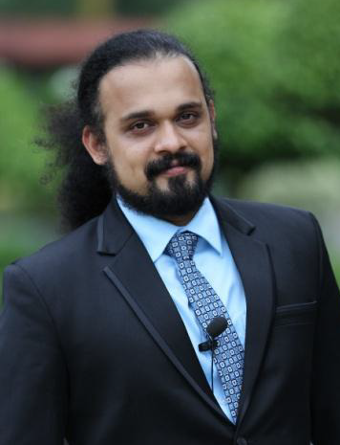
HARRISH SAIRAMAN
Successfully driven over 3000+ workshops touching lives of over 3,00,000+ participants .
Masters in Sciences Like Neuro-Linguistic Programming (NLP), Kinesiology, Integral Eye Movement Therapy, Subconscious Programming, Hypnotherapy, Conversational Hypnosis for performance improvement
Certified Performance and Life Coach
Advance Trainer and Facilitator of Breakthrough Activities – Like Fire Walk, Rod Bending, Broken Glass Walk and Tile breaking along with experiential and adventure activities.
Conducted more than 500+ fire walk seminars.
Coached over 500+ individuals on Performance and Life for breaking barriers in the areas of profession, relationships, health, money etc.
CO - FOUNDER & TRANSFORMATIONAL COACH
THE NEXT DIMENSION
CORPORATE PRESENTATION

Slide 6
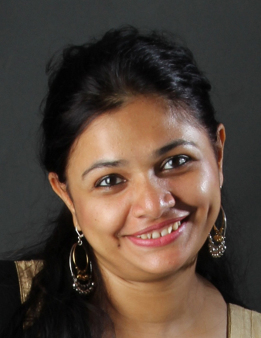
LEKHA HARRISH SAIRAMAN
Lekkha Harrish is a Dale Carnegie certified trainer, has years of experience in the industry.
Lekkha is a certified Fire Walk Instructor and has facilitated Fire Walk, Broken Glass Walk and Rod Bending Seminars. Lekkha also offers workshops in the areas of communication, motivation, team building and Peak Performance.
An arts graduate, Lekkha is also certified by the California Hypnosis Institute of India. She has over the years honed skills integral to the corporate world and has been instrumental in changing training methodologies to bring about maximum learning. She has been conducting workshops in the corporate world at various levels.
FOUNDER & TRAINER
THE NEXT DIMENSION
CORPORATE PRESENTATION

Slide 7
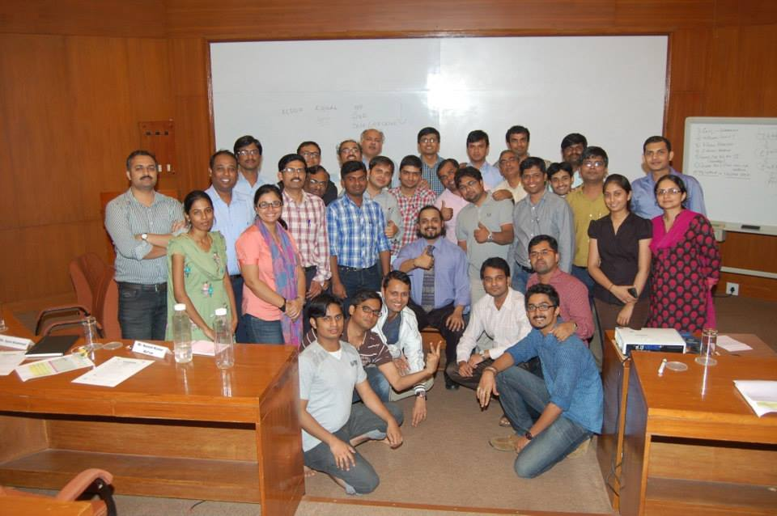
LIST OF OUR WORKSHOPS
Understanding ‘Accelerated’ performance
Fire Walk Briefing
The power of Willingness
Kinesiology Breakthrough Activity (Optional)
Creating a Powerful Environment
Rod Bending
The Power of Ownership
Psychology and Biology of FOCUS
Conflict Simulation
Goal Setting
Power of Perceptions
Theory of Mind
CORPORATE PRESENTATION

Slide 8
OBJECTIVES & BENEFITS
To make participants understand the power of beliefs and believe in themselves.
To create a mindset for ‘a quantum leap’
To appreciate ‘High Pressures’ and embrace them to achieve Peak Performance as an individual and as a team
To understand and experience the ‘Breakthrough Formula’ and focus on the bigger picture
CORPORATE PRESENTATION

Slide 9
OBJECTIVES & BENEFITS
To program the mind with the right beliefs, perceptions and focus to deliver the best in tough market conditions also
To focus on ‘Possibilities’ and set massive Goals
To convert desires into realities with the power of Transformational Tools
To build the ‘I CAN’ attitude and value ‘Commitments’
CORPORATE PRESENTATION

Slide 10
ESTEEMED CLIENTS

Slide 11
ESTEEMED CLIENTS

Slide 12
CLIENT’S TESTIMONIAL
“Harrish is our go-to person. If it’s not his area of expertise, he will state so. And if it is, he always unfailingly delivers programmes which ensure participants walk away with a spring in their step, feeling empowered with the new knowledge and confident in their ability to apply it. Harrish’s ability to make difficult concepts simple and relatable, deliver with panache and ensure he handholds participants through a workshop … is what makes his workshops unique and valuable for each Star employee.”
Kankana Das - Head L&D, Star India
Harrish, your session was really a Fantastic and Genuine effort to make people realize their inner potential and come out of their apprehensions. The session has benefited us to realize the importance of team dynamics and handle change effectively.
Ravindra Dharkar - Head Learning & Development, Lafarge

Slide 13
CLIENT’S TESTIMONIAL
Harrish, what is striking is that your session focuses both on individual and organization development and testimonies from the participants many months after the workshop prove the effectiveness of the session in individual development.
Riyaz Mulla - Location Head, Education Services Group, Tech Mahindra
It was a Fantastic session delivered for Al Batha. Harrish is an excellent trainer and people are still going gaga about it. The session was different and a fresh perspective on how we look at things. I am sure more sessions like these will create a shift in our organization.
Sabiha Kazi - Group Learning and Development Manager, AlBatha Group

Slide 14
CLIENT’S TESTIMONIAL
One of the most Awesome program I have ever been through. It was Fantastic in terms of Energizing and Motivating and makes you believe that ‘You can WIN’
V.S.Raj - Sr. VP & Head BnFS, SYNTEL
“Dear Harrish, Thanks for conducting a wonderful workshop. The energy level was great and the whole team was raving about this session. I think your workshop has contributed to making this offsite an unforgettable one for all of us. We look forward to working with you on future interventions as well. Thanks a lot”
Sriram SR - Head - Human capital, D.E.Shaw India Software Pvt Ltd

Slide 15
CLIENT’S TESTIMONIAL
“Harrish’s session was one of the best sessions that I have attended in the area of setting goals, managing performance and relationships with team members.”
Head – Operations & Commercial Operations Head, Star India
“I have organized and attended motivational programs before but the kind of response this one created is simply awesome. Harrish, everyone is impressed with your genuineness, approachability & one to one connectivity. I attended this the second time but never got bored or felt that its repetitive or old wine in new bottle. That is something very difficult to achieve for a motivational trainer”
Shilpa Desai, Specialist HR IDBI Trusteeship Services Ltd.

Slide 16
Thank You for your time and consideration.
OFFICIAL ADDRESS
1401, Mita Heights, Plot 51B, Kharghar, Sector 20, Navi Mumbai - 410210.
M: +91-9820342769 / +91-9820683763
www.thenextdimension.org | info@thenextdimension.org www.harrishsairaman.com

